Slide 1
Dr. Yifeng Zhu Electrical and Computer Engineering University of Maine
Embedded Systems with ARM Cortex-M Microcontrollers in Assembly Language and C
Chapter 21
Digital-to-Analog Converter (DAC)
Spring 2020

Slide 2
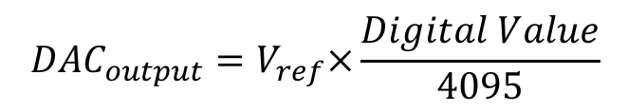
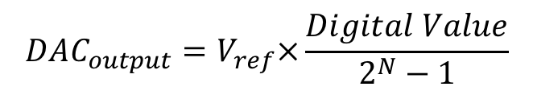
Digital-to-analog converter (DAC)
Converts digital data into a voltage signal by a N-bit DAC
For 12-bit DAC
Many applications:
digital audio
waveform generation
Performance parameters
speed
resolution
power dissipation
$${DAC}_{output}=V_{ref}×\frac{Digital Value}{2^{N}−1}$$
$${DAC}_{output}=V_{ref}×\frac{Digital Value}{4095}$$

Slide 3
DAC Implementations
Pulse-width modulator (PWM)
Binary-weighted resistor (We will use this one as an example)
R-2R ladder (A special case of binary-weighted resistor)

Slide 4
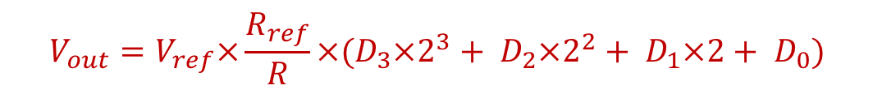

Binary-weighted Resistor DAC
Reference Voltage
4-bit digital value:
$$D_{3}D_{2}D_{1}D_{0}$$
Analog
output
$$V_{out}=V_{ref}×\frac{R_{ref}}{R}×(D_{3}×2^{3}+ D_{2}×2^{2}+ D_{1}×2+ D_{0})$$

Slide 5
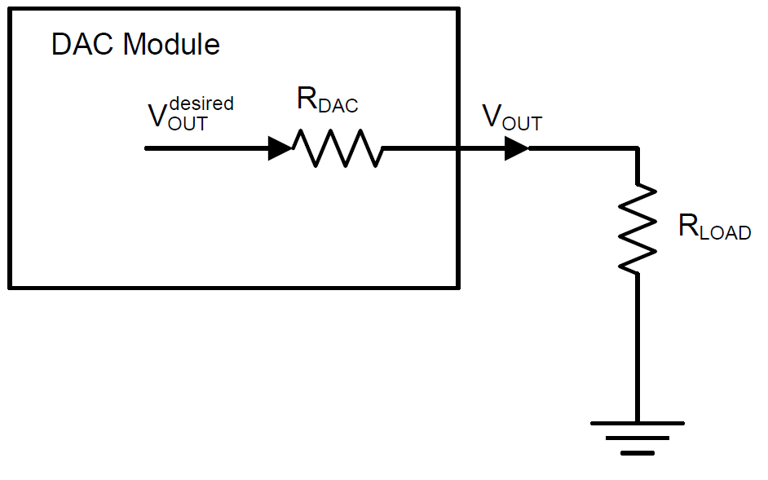

Buffered Output
Load Effect
$$V_{OUT}=\frac{R_{LOAD}}{R_{DAC}+R_{LOAD}}×V_{OUT}^{desired}$$

Slide 6
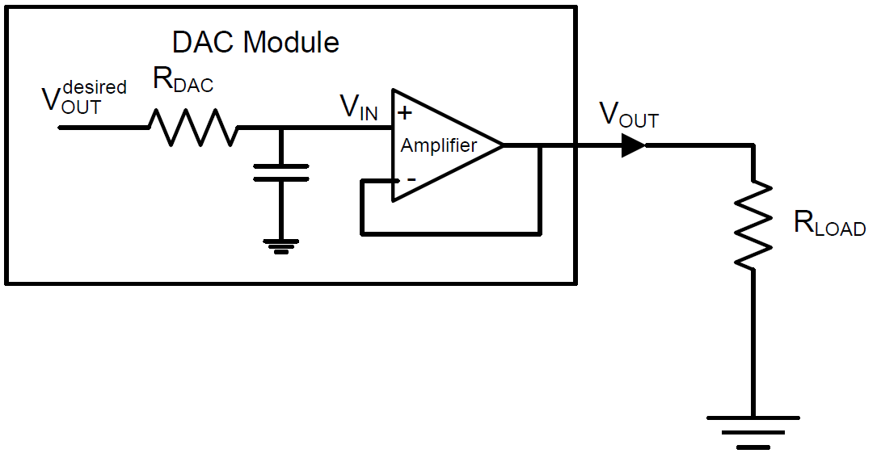

Buffered Output
Use buffer to remove load effect
$$V_{OUT}≈V_{OUT}^{desired}$$

Slide 7
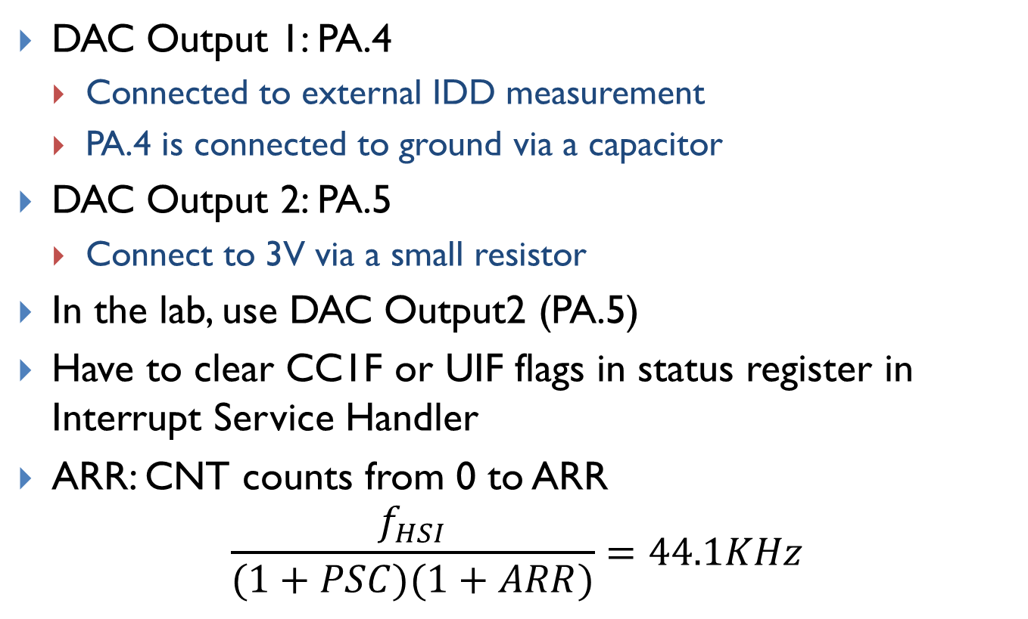
DAC Update
DAC Output 1: PA.4
Connected to external IDD measurement
PA.4 is connected to ground via a capacitor
DAC Output 2: PA.5
Connect to 3V via a small resistor
In the lab, use DAC Output2 (PA.5)
Have to clear CC1F or UIF flags in status register in Interrupt Service Handler
ARR: CNT counts from 0 to ARR
$$\frac{f_{HSI}}{(1+PSC)(1+ARR)}=44.1KHz$$

Slide 8
Digital Music

Slide 9

Digital Music
 | 0 | 1 | 2 | 3 | 4 | 5 | 6 | 7 | 8
C | 16.352 | 32.703 | 65.406 | 130.813 | 261.626 | 523.251 | 1046.502 | 2093.005 | 4186.009
C# | 17.324 | 34.648 | 69.296 | 138.591 | 277.183 | 554.365 | 1108.731 | 2217.461 | 4434.922
D | 18.354 | 36.708 | 73.416 | 146.832 | 293.665 | 587.330 | 1174.659 | 2349.318 | 4698.636
D# | 19.445 | 38.891 | 77.782 | 155.563 | 311.127 | 622.254 | 1244.508 | 2489.016 | 4978.032
E | 20.602 | 41.203 | 82.407 | 164.814 | 329.628 | 659.255 | 1318.510 | 2637.020 | 5274.041
F | 21.827 | 43.654 | 87.307 | 174.614 | 349.228 | 698.456 | 1396.913 | 2793.826 | 5587.652
F# | 23.125 | 46.249 | 92.499 | 184.997 | 369.994 | 739.989 | 1479.978 | 2959.955 | 5919.911
G | 24.500 | 48.999 | 97.999 | 195.998 | 391.995 | 783.991 | 1567.982 | 3135.963 | 6271.927
G# | 25.957 | 51.913 | 103.826 | 207.652 | 415.305 | 830.609 | 1661.219 | 3322.438 | 6644.875
A | 27.500 | 55.000 | 110.000 | 220.000 | 440.000 | 880.000 | 1760.000 | 3520.000 | 7040.000
A# | 29.135 | 58.270 | 116.541 | 233.082 | 466.164 | 932.328 | 1864.655 | 3729.310 | 7458.620
B | 30.868 | 61.735 | 123.471 | 246.942 | 493.883 | 987.767 | 1975.533 | 3951.066 | 7902.133
For a pitch p, its frequency f
$$f=440×2^{(p−69)/12}$$

Slide 10
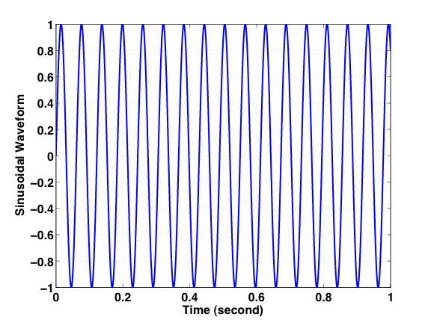
Digital Music
Generate Sine Wave
No FPU available on the processor to compute sine functions
Software FP to compute sine is slow
Solution: Table Lookup
Compute sine values and store in table as fix-point format
Look up the table for result
Linear interpolation if necessary
sin(0.4014257)
= 0.4014257 − 0.40142573/3! + 0.40142575/5! − 0.40142577/7!
= 0.4014257 − 0.0107811296737492 + 0.000086864959350 − 0.000000333277256
= 0.390731102008345
floating-point operations

Slide 11
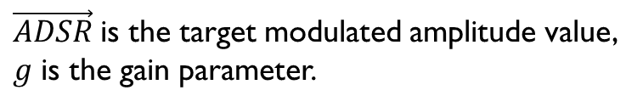
Digital Music: Attack, Decay, Sustain, Release (ADSR)
Implemented by a simple digital filter:
$$ADSR\left(n\right)=g×\vec{ADSR}+(1−g)×ADSR(n−1)$$
where
$\vec{ADSR}$ is the target modulated amplitude value, $g$ is the gain parameter.

Slide 12
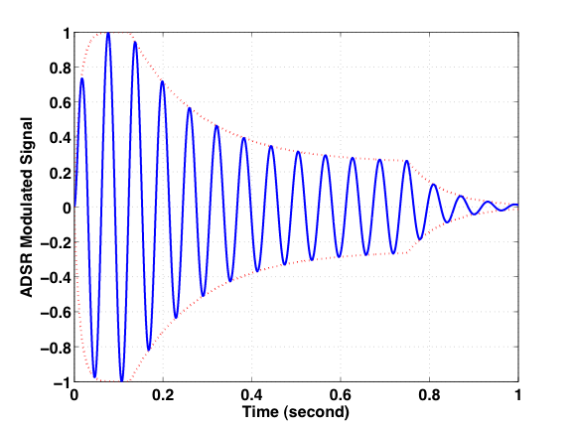
Digital Music ADSR Amplitude Modulation
+

